Slide 1
GENETIC MARKERS
Dr. Muhammad Tahir
Assistant Professor
COMSATS University Islamabad,
Attock Campus

Slide 2
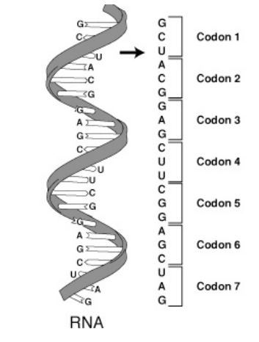
Codons and RFs

Slide 3
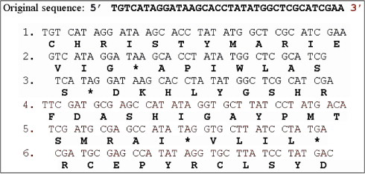
ORFs (open reading frame)
An ORF is the part of a reading frame that has the potential to be translated. An ORF is a continuous stretch of codons that contain a start codon (usually AUG) and a stop codon (usually UAA, UAG or UGA)
6 Reading Frames

Slide 4
DNA fingerprinting
A technique used by scientists to distinguish between individuals of the same species using only samples of their DNA.
It is a technique, by which an individual can be identified at molecular level.
Primer
A short (single strand) oligonucleotide sequence of 10-15 nucleotides used in a polymerase chain reaction (PCR)
Genetic Marker
A DNA polymorphism that can be easily detected by molecular or biochemical analysis.
The marker can be within a gene or in DNA with no known function.
Because DNA segments that lie near each other on a chromosome tend to be inherited together, markers are often used as indirect ways of tracking the inheritance pattern of a gene that has not yet been identified, but whose approximate location is known.

Slide 5
Marker
Gene of known function and location
Gene that allows studying the inheritance of that gene
Genetic information resides in the genome
Genetic Marker
Any phenotypic difference controlled by genes, that can be used for studying recombination processes or selection of a more or less closely associated target gene
Anything in the genome that is variable and can be used to compare individuals
Detectable allelic variation on a chromosome can be a phenotype, can also be a unique detectable sequence of DNA

Slide 6
Genetic Marker
Morphological marker
Molecular marker
1. Protein marker
2. DNA marker

Slide 7
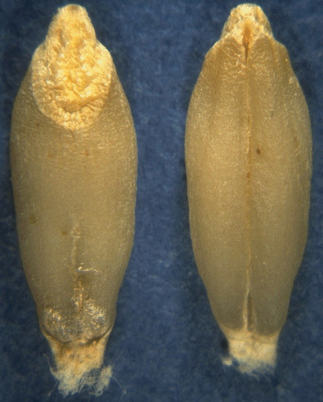
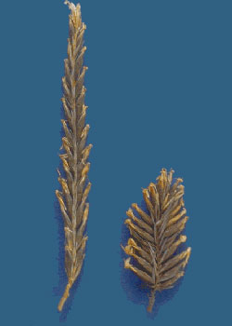
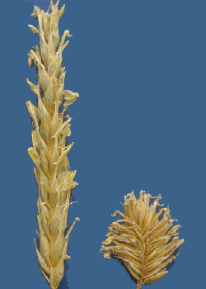
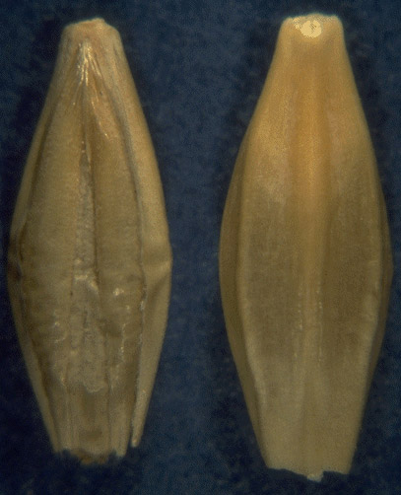
Morphological Marker
Phenotypic markers
Naked eye marker
hulled naked
Black white

Slide 8
Molecular Markers
Readily detectable sequence of protein or DNA that are closely linked to a gene locus and/or a morphological or other characters of a plant
Readily detectable sequence of protein or DNA whose inheritance can be monitored and associated with the trait inheritance independently from the environment
Types:
a) protein polymorphisms
b) DNA polymorphisms

Slide 9
Molecular markers
Sequencing (SNPs)
Microsatellites (SSRs)
Resolution power
Multi-locus fingerprints (RFLP)
AFLP
(Amplified Fragment Length Polymorphism)
RAPD
(random amplified polymorphic DNA)
allozymes (protein-electrophoresis)
Notes:
SSR: Simple Sequence Repeat

Slide 10
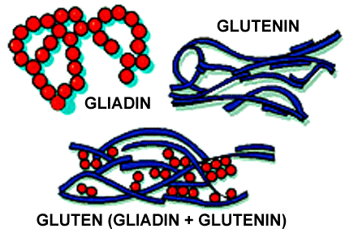
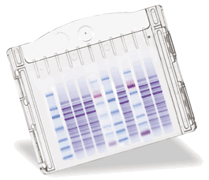
Proteins Markers
Allozymes:
Isoenzymes of protein nature whose synthesis is usually controlled by codominant alleles and inherited by monogenic ratios
Isozymes:
A species of enzyme that exists into two or more structural forms which are easily identified by their activities

Slide 11
DNA Marker
1 ccacgcgtcc gtgaggactt gcaagcgccg cggatggtgg gctctgtggc tgggaacatg 61 ctgctgcgag ccgcttggag gcgggcgtcg ttggcggcta cctccttggc cctgggaagg 121 tcctcggtgc ccacccgggg actgcgcctg cgcgtgtaga tcatggcccc cattcgcctg 181 ttcactcaga ggcagaggca gtgctgcgac ctctctacat ggacgtacag gccaccactc 241 ctctggatcc cagagtgctt gatgccatgc tcccatacct tgtcaactac tatgggaacc 301 ctcattctcg gactcatgca tatggctggg agagcgaggc agccatggaa cgtgctcgcc 361 agcaagtagc atctctgatt ggagctgatc ctcgggagat cattttcact agtggagcta 421 ctgagtccaa caacatagca attaaggtag gaggagggat ggggatgttg tgtggccgac 481 agttgtgagg ggttgtggga agatggaagc cagaagcaaa aaagagggaa cctgacacta 541 tttctggctt cttgggttta gcgattagtg cccctctctc atttgaactc aactacccat 601 gtctccctag ttctttctct gcctttaaaa aaaaatgtgt ggaggacagc tttgtggag
DNA
M₁
M₂
Gene A
Gene B
MFG
MFG
AACCTGAAAAGTTACCCTTTAAAGGCTTAAGGAA
AAAGGGTTTAACCAAGGAATTCCATCGGGAATTCCG
Readily detectable sequence of DNA whose inheritance can be monitored and associated with the trait inheritance

Slide 12
DNA Marker
Hybridization molecular based markers
PCR molecular based markers
Hybridization based markers
Examine differences in size of specific DNA restriction fragments
Require pure, high molecular weight DNA and probe
Usually performed on total cellular genome

Slide 13
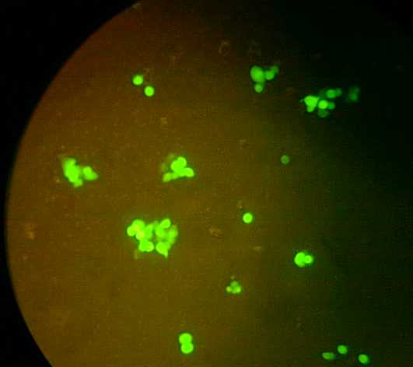
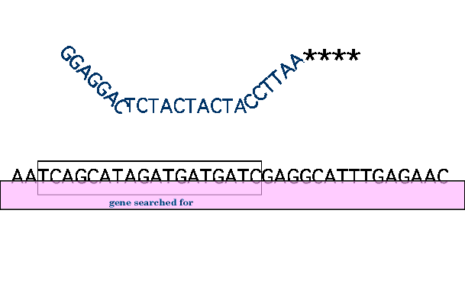
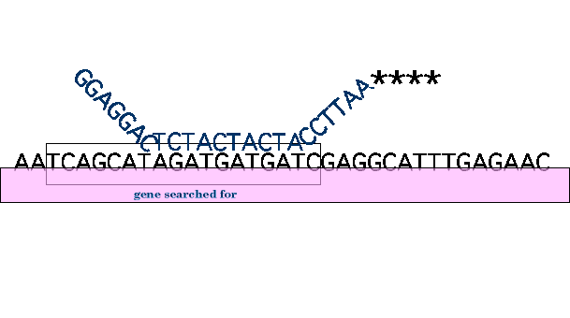
DNA/DNA Hybridization
Denaturation
Elevated temperature
Restriction Fragment Length Polymorphism
Known DNA sequence

Slide 14
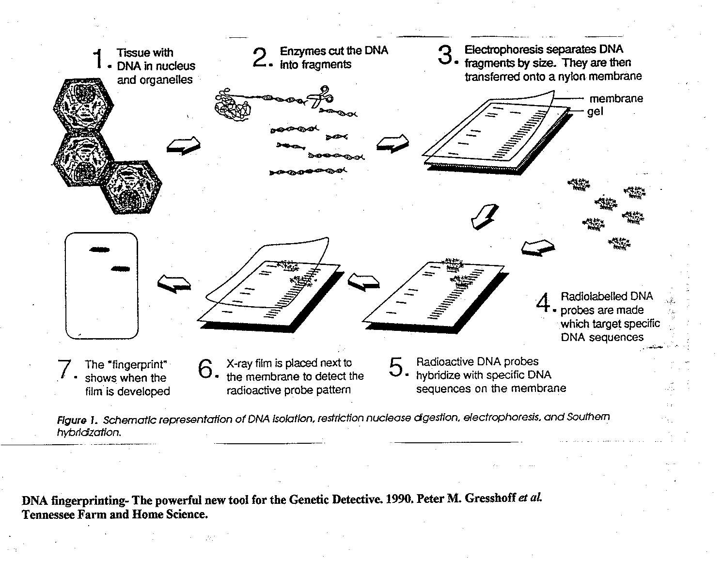
RFLP techniques

Slide 15
RFLP Polymorphisms interpretation
MFG
1
1
2
3
4
5
6
2
3
4
5
6

Slide 16
Advantages and disadvantages
Advantages
  Reproducible
  Co-dominant
  Simple
Disadvantages
  Time consuming
  Expensive
  Use of radioactive probes

Slide 17
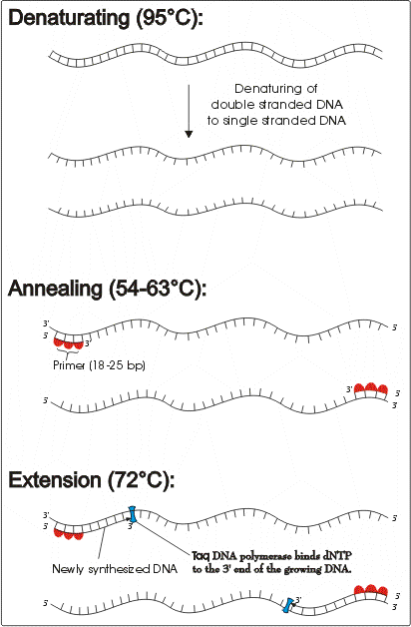
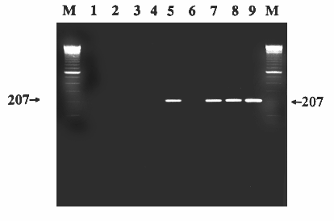
Polymerase Chain Reaction
Powerful technique for amplifying DNA
Amplified DNA are then separated by gel electrophoresis

Slide 18
PCR Based markers
Sequencing (SNPs)
Microsatellites (SSR)AFLP (Amplified Fragment Length Polymorphism)
RAPD (random amplified polymorphic DNA)

Slide 19
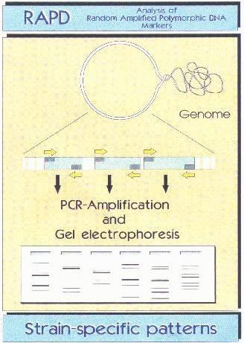
RAPD Markers
DNA markers which developed by amplifying random sequence of specific markers through the used of random primers

Slide 20
RAPD
Advantages:
Amplifies anonymous stretches of DNA using arbitrary primers
Fast and easy method for detecting polymorphisms
Disadvantages:
Dominant markers
Reproducibility problems

Slide 21
RAPD Markers
RAPD markers need to be converted to stable PCR markers.
The polymorphic RAPD marker band is isolated from the gel
It is used a template and re-PCRed
The new PCR product is cloned and sequenced
Once the sequence is determined, new longer and specific primers can be designed

Slide 22
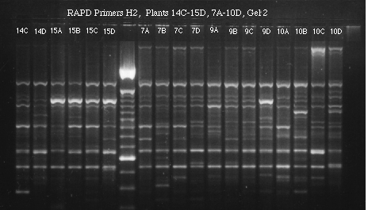
RAPD Polymorphisms among landraces of sorghum
Sequences of 10-mer
RAPD primers
Name Sequence
OP A08 5’ –GTGACGTAGG- 3’
OP A15 5’ –TTCCGAACCC- 3’
OP A 17 5’ –GACCGCTTGT- 3’
OP A19 5’ –CAAACGTCGG- 3’
OP D02 5’ –GGACCCAACC- 3’
M
RAPD gel configuration

Slide 23
AFLP Markers
Most complex of marker technologies
Involves cleavage of DNA with two different enzymes
Involves ligation of specific linker pairs to the digested DNA
Subsets of the DNA are then amplified by PCR
The PCR products are then separated on acrylamide gel
128 linker combinations are readily available
Therefore 128 subsets can be amplified
Patented technology

Slide 24
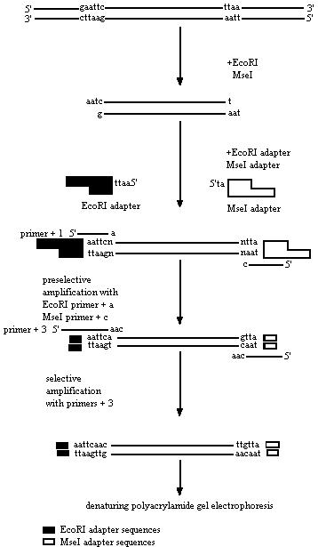

Slide 25
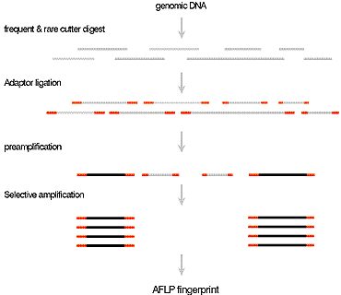

Slide 26
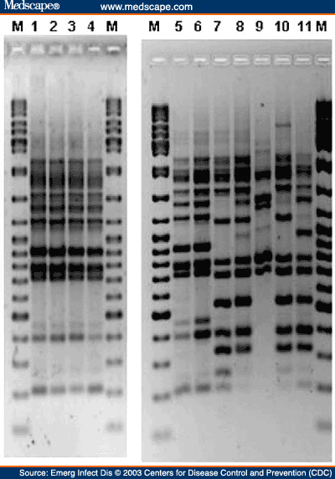

Slide 27
AFLP Markers
Technically demanding
Reliable and stable
Moderate cost
Need to use different kits adapted to the size of the genome being analyzed.
Like RAPD markers need to be converted to quick and easy PCR based marker

Slide 28
SSR (Simple sequence repeat)
DNA markers which developed by amplifying microsatellite in the genome
Sequence Primer
ACTGTCGACACACACACACACGCTAGCT (AC)₇
TGACAGCTGTGTGTGTGTGTGCGATCGA
ACTGTCGACACACACACACACACGCTAGCT (AC)₈
TGACAGCTGTGTGTGTGTGTGTGCGATCGA
ACTGTCGACACACACACACACACACACGCTAGCT (AC)₁₀
TGACAGCTGTGTGTGTGTGTGTGTGTGCGATCGA
ACTGTCGACACACACACACACACACACACACGCTAGCT (AC)₁₂
TGACAGCTGTGTGTGTGTGTGTGTGTGTGTGCGATCGA

Slide 29
SSR polymorphisms
P₁
AATCCGGACTAGCTTCTTCTTCTTCTTCTTTAGCGAATTAGG
P₂
AAGGTTATTTCTTCTTCTTCTTCTTCTTCTTCTTAGGCTAGGCG
P₁
P₂
Gel configuration

Slide 30
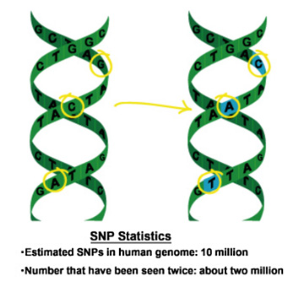
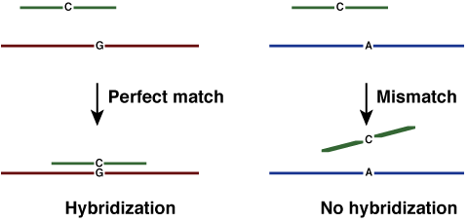
SNPs
(Single Nucleotide Polymorphisms)
DNA markers which their polymorphism can be determined by single nucleotide difference
SNPs on a DNA strand
Hybridization using fluorescent dyes
Any two unrelated individuals differ by one base pair every 1,000 or so, referred to as SNPs.
Many SNPs have no effect on cell function and therefore can be used as molecular markers.

Slide 31
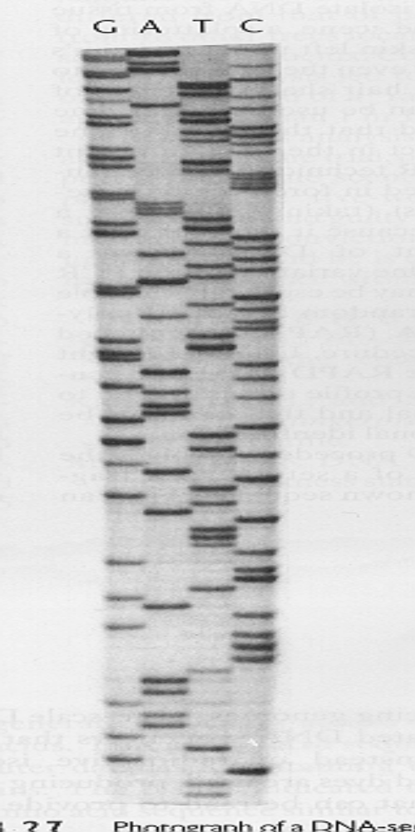
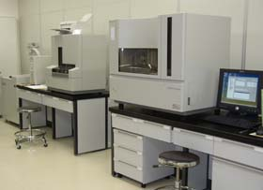
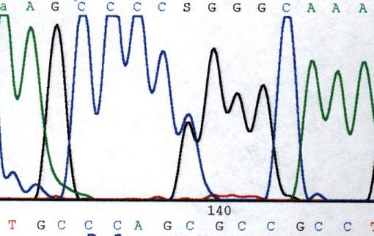
DNA sequencing
Sequencer
Sequencing gel
Sequencing graph

Slide 32
Genetic marker characteristics
Characteristics | Morphological markers | Protein markers | RFLP markers | RAPD markers | SSR markers
Number of loci | Limited | Limited | Almost unlimited | Unlimited | High
Inheritance | Dominant | Codominant | Codominant | Dominant | Codominant
Positive features | Visible | Easy to detect | Utilized before the latest technologies were available | Quick assays with many markers | Well distributed within the genome, many polymorphism
Negative features | Possibly negative linkage to other characters | Possibly tissue specific | Radioactivity requirements, rather expensive | High basic investment | Long development of the markers, expensive

Slide 33
Co-dominant marker
Gel configuration
Polymorphism
-Parent 1 : one band
-Parent 2 : a smaller band
-Offspring 1 : heterozygote = both bands
-Offspring 2 : homozygote parent 1
P ₁
P ₂
O ₁
O ₂
Dominant marker
Polymorphism
Parent 1 : one band
-Parent 2 : no band
-Offspring 1 : homozygote parent 1
-Offspring 2 : ????
Gel configuration
P ₁
P ₂
O ₁
O ₂

Slide 34
Desirable properties
Polymorphic
Co-dominant inheritance
Occurs throughout the genome
Reproducible
Easy, fast and cheap to detect
Selectivity neutral
High resolution with large number of samples

